Slide 1
UNIT - 4 :TRANSACTIONS SUB :RDBMS
Semester :3rd sem
JAIN UNIVERSITY SCHOOL OF COMPUTER SCIENCE AND IT DEPARTMENT OF BCA

Slide 2
Transaction
Transaction is a unit of work that is performed against a database.
Transactions are units or sequences of work accomplished in a logical order, whether in a manual fashion by a user or automatically by some sort of a database program.

Slide 3
Properties of Transactions
Atomicity − ensures that all operations within the work unit are completed successfully. Otherwise, the transaction is aborted at the point of failure and all the previous operations are rolled back to their former state.
Consistency − ensures that the database properly changes states upon a successfully committed transaction.
Isolation − enables transactions to operate independently of and transparent to each other.
Durability − ensures that the result or effect of a committed transaction persists in case of a system failure.

Slide 4
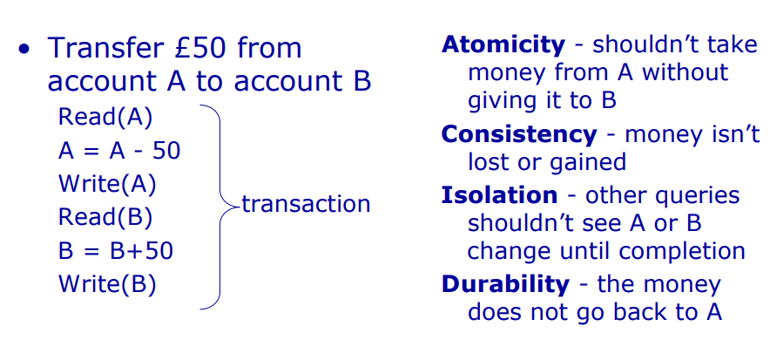
Example

Slide 5
Transaction Control
The following commands are used to control transactions.
COMMIT − to save the changes.
ROLLBACK − to roll back the changes.
SAVEPOINT − creates points within the groups of transactions in which to ROLLBACK.
SET TRANSACTION − Places a name

Slide 6
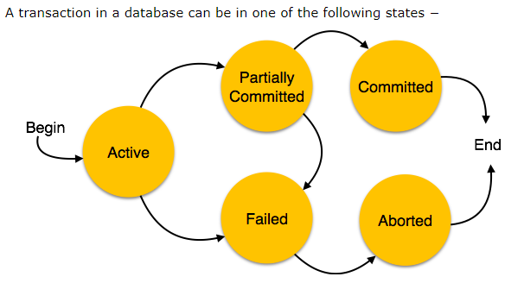
State of Transaction

Slide 7
State of Transaction
Active − In this state, the transaction is being executed. This is the initial state of every transaction.
Partially Committed − When a transaction executes its final operation, it is said to be in a partially committed state.
Committed − If a transaction executes all its operations successfully, it is said to be committed. All its effects are now permanently established on the database system.
Failed − A transaction is said to be in a failed state if any of the checks made by the database recovery system fails. A failed transaction can no longer proceed further.
Aborted − If any of the checks fails and the transaction has reached a failed state, then the recovery manager rolls back all its write operations on the database to bring the database back to its original state where it was prior to the execution of the transaction. Transactions in this state are called aborted. The database recovery module can select one of the two operations after a transaction aborts −
Re-start the transaction
Kill the transaction

Slide 8
DBMS - Concurrency Control
In a multiprogramming environment where multiple transactions can be executed simultaneously,
it is highly important to control the concurrency of transactions.
We have concurrency control protocols to ensure atomicity, isolation, and serializability of concurrent transactions.
Concurrency control protocols can be broadly divided into three categories −
Lock based protocols
Time stamp based protocols
Optimistic Concurrency Control

Slide 9
Lock-based Protocols
Database systems equipped with lock-based protocols use a mechanism by which any transaction cannot read or write data until it acquires an appropriate lock on it.
Locks are of two kinds −
Binary Locks −
A lock on a data item can be in two states; it is either locked or unlocked.
Shared/exclusive −
This type of locking mechanism differentiates the locks based on their uses.
If a lock is acquired on a data item to perform a write operation, it is an exclusive lock.
Allowing more than one transaction to write on the same data item would lead the database into an inconsistent state.
Read locks are shared because no data value is being changed.

Slide 10
There are four types of lock protocols available
Simplistic Lock Protocol
Pre-claiming Lock Protocol
Two-Phase Locking 2PL
Strict Two-Phase Locking

Slide 11
One-phase Locking Protocol
In this method, each transaction locks an item before use and releases the lock as soon as it has finished using it. This locking method provides for maximum concurrency but does not always enforce serializability.

Slide 12
Two-phase Locking Protocol
In this method, all locking operations precede the first lock-release or unlock operation. The transaction comprise of two phases. In the first phase, a transaction only acquires all the locks it needs and do not release any lock. This is called the expanding or the growing phase. In the second phase, the transaction releases the locks and cannot request any new locks. This is called the shrinking phase.

Slide 13
Intent Locks
When an SQL statement in a transaction first accesses a tablespace with a page or row level lock, DB2 first takes a particular type of lock, called an intent lock, at the table and tablespace level for a segmented tablespace or tablespace level for a non-segmented tablespace.
Intent locks do not conflict with read locks, so acquiring an intent lock does not block other transactions from reading the same row.
However, intent locks do prevent other transactions from acquiring either an intent lock or a write lock on the same row, guaranteeing that the row cannot be changed by any other transaction before an update.

Slide 14
What is Serializability in DBMS?
When multiple transactions are running concurrently then there is a possibility that the database may be left in an inconsistent state.
Serializability is a concept that helps us to check which schedules are serializable.
A serializable schedule is the one that always leaves the database in consistent state.

Slide 15
What is a serializable schedule?
A serializable schedule always leaves the database in consistent state.
A serial schedule is always a serializable schedule because in serial schedule, a transaction only starts when the other transaction finished execution. However a non-serial schedule needs to be checked for Serializability.

Slide 16
Types of Serializability:
Conflict Serializability
View Serializability

Slide 17
Deadlock:
In a multi-process system, deadlock is an unwanted situation that arises in a shared resource environment, where a process indefinitely waits for a resource that is held by another process.
For example, assume a set of transactions {T₀, T₁, T₂, ...,T_{n}}. T₀ needs a resource X to complete its task.
Resource X is held by T₁, and T₁ is waiting for a resource Y, which is held by T₂. T₂ is waiting for resource Z, which is held by T₀.
Thus, all the processes wait for each other to release resources. In this situation, none of the processes can finish their task. This situation is known as a deadlock.
Deadlocks are not healthy for a system. In case a system is stuck in a deadlock, the transactions involved in the deadlock are either rolled back or restarted

